Slide 1
CDI Resolución de Ejercicios

Slide 2
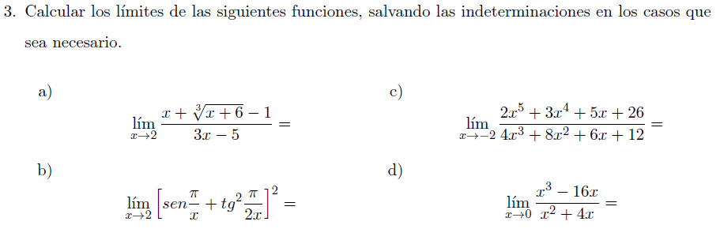
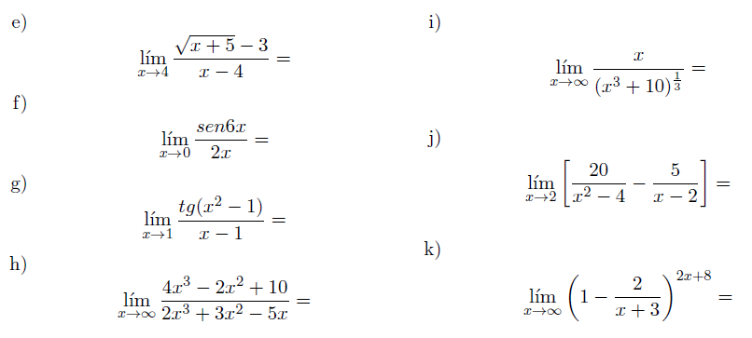

Slide 3


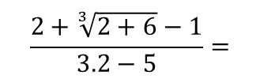
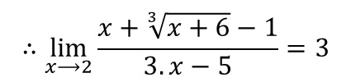






$$\lim_{x⟶2}{\frac{x+\sqrt[3]{x+6}−1}{3.x−5}=}$$
$$\frac{2+\sqrt[3]{2+6}−1}{3.2−5}=$$
$$\frac{3}{1}$$
$$∴\lim_{x⟶2}{\frac{x+\sqrt[3]{x+6}−1}{3.x−5}=3}$$
$$\lim_{x⟶2}{sen\frac{π}{x}+{tg}^{2}\frac{π}{2.x}=}$$
$$sen\frac{π}{2}+{tg}^{2}\frac{π}{2.2}=$$
$$sen\frac{π}{2}+{tg}^{2}\frac{π}{4}=2^{2}=4$$
$$∴\lim_{x⟶2}{sen\frac{π}{x}+{tg}^{2}\frac{π}{2.x}=4}$$

Slide 4

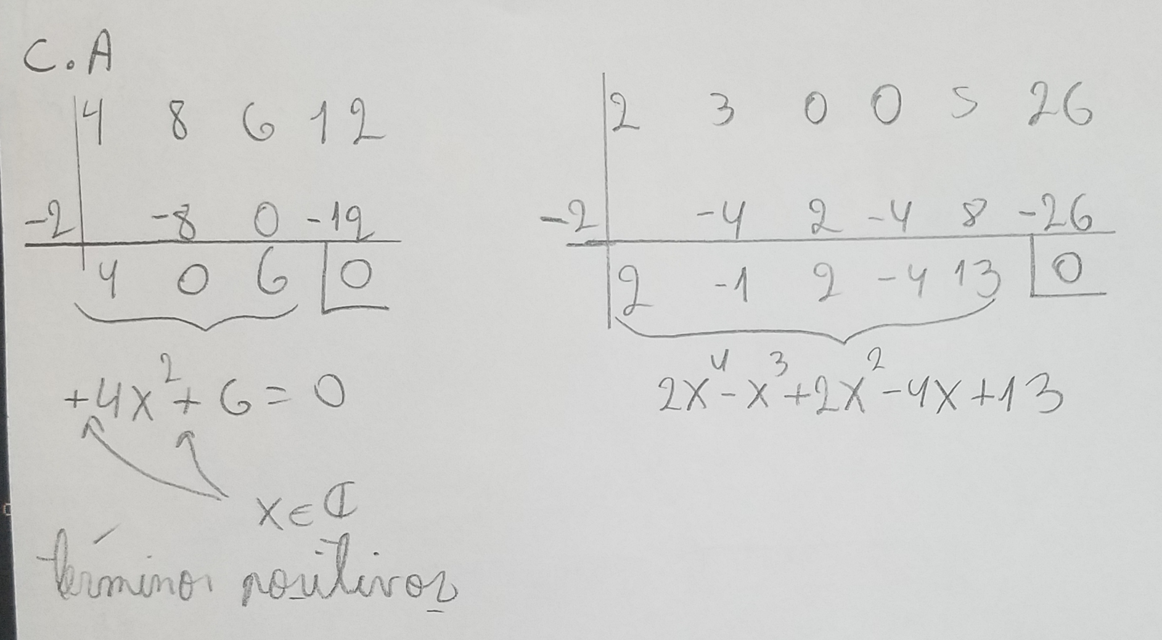
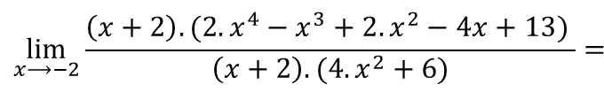
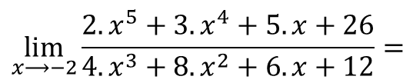

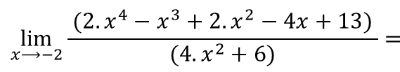

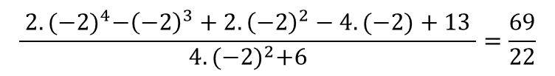
Indeterminación del tipo $\frac{0}{0}$
$$\lim_{x⟶−2}{\frac{2.x^{5}+3.x^{4}+5.x+26}{4.x^{3}+8.x^{2}+6.x+12}=}$$
$$\lim_{x⟶−2}{\frac{\left(x+2\right).(2.x^{4}−x^{3}+2.x^{2}−4x+13) }{\left(x+2\right).(4.x^{2}+6)}=}$$
$$\lim_{x⟶−2}{\frac{ (2.x^{4}−x^{3}+2.x^{2}−4x+13) }{(4.x^{2}+6)}=}$$
$$\frac{ 2.{(−2)}^{4}−{\left(−2\right)}^{3}+2.{\left(−2\right)}^{2}−4.(−2)+13 }{4.{(−2)}^{2}+6}=\frac{69}{22}$$
Cálculos auxiliares
$$∴\lim_{x⟶−2}{\frac{2.x^{5}+3.x^{4}+5.x+26}{4.x^{3}+8.x^{2}+6.x+12}=}\frac{69}{22}$$

Slide 5




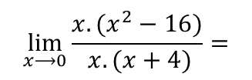
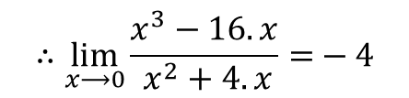

Indeterminación del tipo $\frac{0}{0}$
$$\lim_{x⟶0}{\frac{x^{3}−16.x}{ x^{2}+4.x}=}$$
$$\lim_{x⟶0}{\frac{{x.(x}^{2}−16)}{ x.(x+4)}=}$$
$$\lim_{x⟶0}{\frac{x^{2}−16}{ x+4}=}$$
$$\frac{0^{2}−16}{ 0+4}=−4$$
$$∴\lim_{x⟶0}{\frac{x^{3}−16.x}{ x^{2}+4.x}=}−4$$

Slide 6

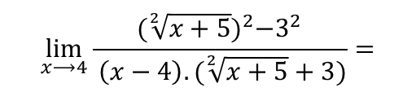

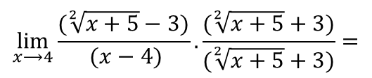
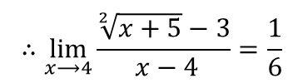
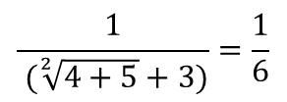
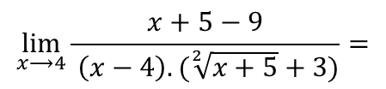
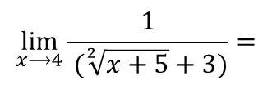
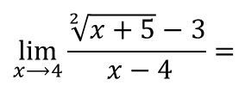
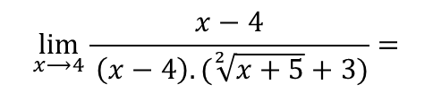
Indeterminación del tipo $\frac{0}{0}$
$$\lim_{x⟶4}{\frac{\sqrt[2]{x+5}−3}{ x−4}=}$$
$$\lim_{x⟶4}{\frac{(\sqrt[2]{x+5}−3)}{ (x−4)}.\frac{(\sqrt[2]{x+5}+3)}{(\sqrt[2]{x+5}+3)}=}$$
$$\lim_{x⟶4}{\frac{{(\sqrt[2]{x+5})}^{2}−3^{2}}{ \left(x−4\right).(\sqrt[2]{x+5}+3)}=}$$
$$\lim_{x⟶4}{\frac{x+5−9}{ \left(x−4\right).(\sqrt[2]{x+5}+3)}=}$$
$$\lim_{x⟶4}{\frac{x−4}{ \left(x−4\right).(\sqrt[2]{x+5}+3)}=}$$
$$\lim_{x⟶4}{\frac{1}{ (\sqrt[2]{x+5}+3)}=}$$
$$\frac{1}{ (\sqrt[2]{4+5}+3)}=\frac{1}{6}$$
$$∴\lim_{x⟶4}{\frac{\sqrt[2]{x+5}−3}{ x−4}=\frac{1}{6}}$$

Slide 7




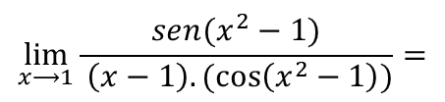

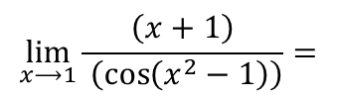


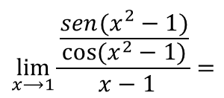

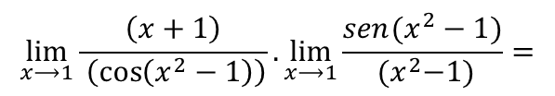




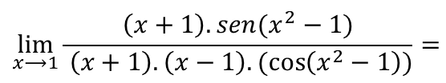

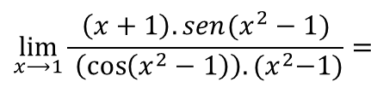


Indeterminación del tipo $\frac{0}{0}$
$$\lim_{x⟶0}{\frac{sen 6.x}{ 2.x}=}$$
$$\lim_{x⟶0}{\frac{3.sen 6x}{3. 2x}=}$$
$$\lim_{x⟶0}{\frac{3.sen 6x}{ 6.x}=}$$
$$\lim_{x⟶0}{3.}\lim_{x⟶0}{\frac{sen 6x}{ 6x}=}$$
$${3.}1=3$$
$$∴\lim_{x⟶0}{\frac{sen 6x}{ 2x}=}3$$
$$1$$
Indeterminación del tipo $\frac{0}{0}$
$$\lim_{x⟶1}{\frac{\frac{sen(x^{2}−1)}{cos⁡(x^{2}−1)}}{ x−1}=}$$
$$\lim_{x⟶1}{\frac{\operatorname{tg}{(x^{2}−1)}}{ x−1}=}$$
$$\lim_{x⟶1}{\frac{sen(x^{2}−1)}{ \left(x−1\right).(\cos\left(x^{2}−1\right))}=}$$
$$\lim_{x⟶1}{\frac{\left(x+1\right).sen(x^{2}−1)}{ \left(x+1\right).\left(x−1\right).(\cos\left(x^{2}−1\right))}=}$$
$$\lim_{x⟶1}{\frac{\left(x+1\right).sen(x^{2}−1)}{ \left(\cos\left(x^{2}−1\right)\right).{(x}^{2}−1)}=}$$
$$\lim_{x⟶1}{\frac{\left(x+1\right)}{ \left(\cos\left(x^{2}−1\right)\right)}.\lim_{x⟶1}{\frac{sen(x^{2}−1)}{ {(x}^{2}−1)}=}}$$
$$\lim_{x⟶1}{\frac{\left(x+1\right)}{ \left(\cos\left(x^{2}−1\right)\right)}}=$$
$$=\frac{1+1}{cos⁡(1^{2}−1)}=2$$
$$1$$
$$∴\lim_{x⟶1}{\frac{\operatorname{tg}{(x^{2}−1)}}{ x−1}=}2$$

Slide 8



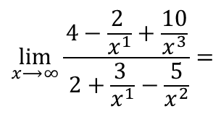
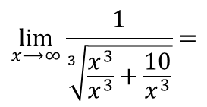

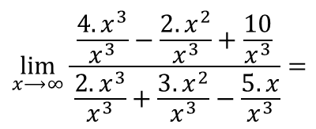
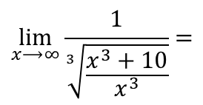
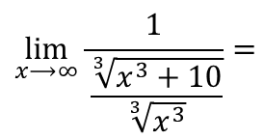



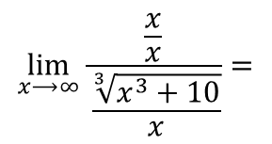
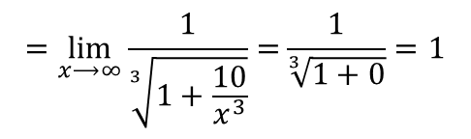


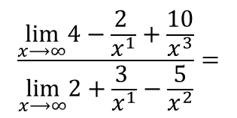
Indeterminación del tipo $\frac{∞}{∞}$
$$\lim_{x⟶∞}{\frac{\frac{{4.x}^{3}}{x^{3}}−\frac{2.x^{2}}{x^{3}}+\frac{10}{x^{3}}}{ \frac{{2.x}^{3}}{x^{3}}+\frac{3.x^{2}}{x^{3}}−\frac{5.x}{x^{3}}}=}$$
$$\lim_{x⟶∞}{\frac{4−\frac{2 }{x^{1}}+\frac{10}{x^{3}}}{ 2+\frac{3 }{x^{1}}−\frac{5}{x^{2}}}=}$$
$$\frac{\lim_{x⟶∞}4−\frac{2 }{x^{1}}+\frac{10}{x^{3}}}{\lim_{x⟶∞}2+\frac{3 }{x^{1}}−\frac{5}{x^{2}}}=$$
$$\lim_{x⟶∞}{\frac{{4.x}^{3}−2.x^{2}+10}{ {2.x}^{3}+3.x^{2}−5.x}=}$$
$$=\frac{4−0+0}{2+0−0}=2$$
$$∴\lim_{x⟶∞}{\frac{{4.x}^{3}−2.x^{2}+10}{ {2.x}^{3}+3.x^{2}−5.x}=}2$$
Indeterminación del tipo $\frac{∞}{∞}$
$$\lim_{x⟶∞}{\frac{\frac{x}{x}}{ \frac{\sqrt[3]{x^{3}+10}}{x}}=}$$
$$\lim_{x⟶∞}{\frac{1}{ \frac{\sqrt[3]{x^{3}+10}}{\sqrt[3]{x^{3}}}}=}$$
$$\lim_{x⟶∞}{\frac{1}{\sqrt[3]{\frac{x^{3}+10}{x^{3}}}}=}$$
$$\lim_{x⟶∞}{\frac{1}{\sqrt[3]{\frac{x^{3}}{x^{3}}+\frac{10}{x^{3}}}}=}$$
$$\lim_{x⟶∞}{\frac{x}{ \sqrt[3]{x^{3}+10}}=}$$
$$=\lim_{x⟶∞}{\frac{1}{\sqrt[3]{1+\frac{10}{x^{3}}}}=}\frac{1}{\sqrt[3]{1+0}}=1$$
$$∴\lim_{x⟶∞}{\frac{x}{ \sqrt[3]{x^{3}+10}}=}1$$

Slide 9


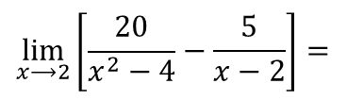
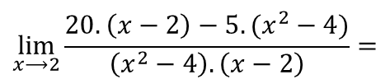
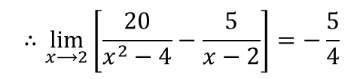



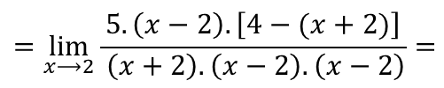

$$\lim_{x⟶2}\left[\frac{20}{x^{2}−4}−\frac{5}{x−2}\right]=$$
$$\lim_{x⟶2}{\frac{20.\left(x−2\right)−5.(x^{2}−4)}{\left(x^{2}−4\right).\left(x−2\right)}=}$$
$$\lim_{x⟶2}{\frac{20.\left(x−2\right)−5.\left(x−2\right).(x+2)}{ \left(x+2\right).\left(x−2\right).\left(x−2\right)}=}$$
$$=\lim_{x⟶2}{\frac{5.\left(x−2\right).\left[4−(x+2)\right]}{ \left(x+2\right).\left(x−2\right).\left(x−2\right)}=}$$
$$\lim_{x⟶2}{\frac{5.\left(x−2\right).\left[−x+2\right]}{ \left(x+2\right).\left(x−2\right).\left(x−2\right)}=}$$
$$\lim_{x⟶2}{\frac{5.\left(x−2\right).\left(−1\right).\left[x−2\right]}{ \left(x+2\right).\left(x−2\right).\left(x−2\right)}=}$$
$$\lim_{x⟶2}{\frac{−5.\left(x−2\right).\left[x−2\right]}{ \left(x+2\right).\left(x−2\right).\left(x−2\right)}=}$$
$$\lim_{x⟶2}{\frac{−5}{ \left(x+2\right)}=}\frac{−5}{2+2}=−\frac{5}{4}$$
$$∴\lim_{x⟶2}\left[\frac{20}{x^{2}−4}−\frac{5}{x−2}\right]=−\frac{5}{4}$$

Slide 10
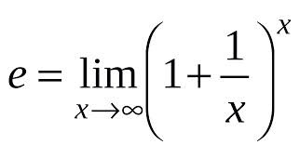

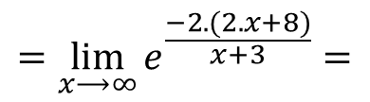
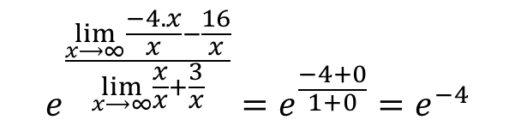
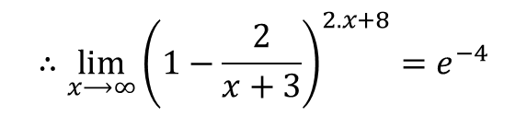
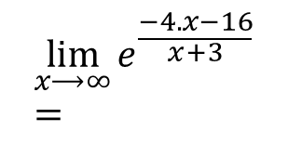
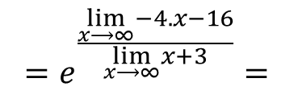
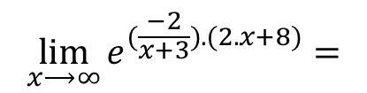
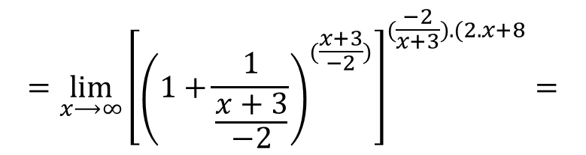
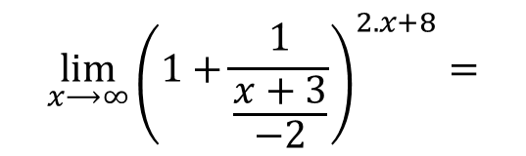
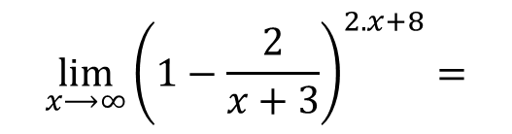
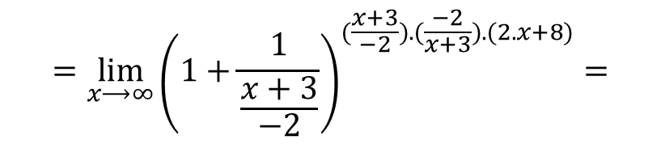
$$\lim_{x⟶∞}{{\left(1−\frac{2}{x+3}\right)}^{2.x+8}}=$$
$$\lim_{x⟶∞}{{\left(1+\frac{1}{\frac{x+3}{−2}}\right)}^{2.x+8}}=$$
$$=\lim_{x⟶∞}{{\left(1+\frac{1}{\frac{x+3}{−2}}\right)}^{(\frac{x+3}{−2}).(\frac{−2}{x+3}).(2.x+8)}}=$$
$$=\lim_{x⟶∞}{{\left[{\left(1+\frac{1}{\frac{x+3}{−2}}\right)}^{(\frac{x+3}{−2})}\right]}^{(\frac{−2}{x+3}).(2.x+8}}=$$
$$\lim_{x⟶∞}{e^{(\frac{−2}{x+3}).(2.x+8)}}=$$
$$=\lim_{x⟶∞}{e^{\frac{−2.(2.x+8)}{x+3}}}=$$
$$\lim_{x⟶∞}{e^{\frac{−4.x−16}{x+3}}}=$$
$$∴\lim_{x⟶∞}{{\left(1−\frac{2}{x+3}\right)}^{2.x+8}}=e^{−4}$$
$$=e^{\frac{\lim_{x⟶∞}−4.x−16}{\lim_{x⟶∞}x+3}}=$$
$$e^{\frac{\lim_{x⟶∞}\frac{−4.x}{x}−\frac{16}{x}}{\lim_{x⟶∞}\frac{x}{x}+\frac{3}{x}}}=e^{\frac{−4+0}{1+0}}=e^{−4}$$

